Slide 1
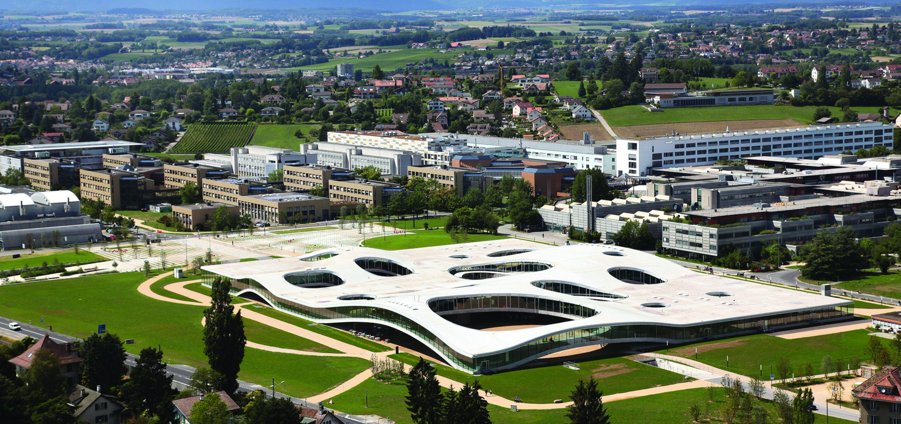
Action Recognition for Self-Driving Cars
VITA EPFL
Semester Project
(15 ECTS)
Student: Weijiang Xiong (Microengineering)
Supervisor: Lorenzo Bertoni, Dr. Taylor Mordan
Date: Nov. 9th 2021
Notes:
Hello everyone, I’m Weijiang Xiong, and today I’m very happy to share my project with you.
This semester I’m working on Action recognition for self-driving cars with Lorenzo and Taylor.
So, first, what is action recognition?
add references for related papers
0- Title, name + Your section & Number of credits for project
1- What s the problem? why is important? (very brief)
2- Precise problem statement. input? output?
3- One previous work (the most relevant/recent one)
4- Your proposed method (it can be the presented previous work)
5- Experiment: what is the dataset, evaluation metrics
6- What have you done so far?
7- What do you plan to do?

Slide 2
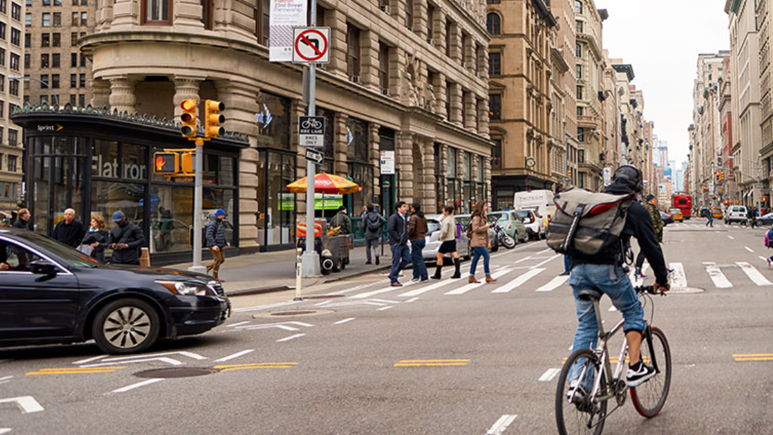
Image taken from https://usa.honda-ri.com/titan
Notes:
Image we are standing on the road, and see a cross like this.
we can easily tell that this man is cycling, these people are walking.

Slide 3
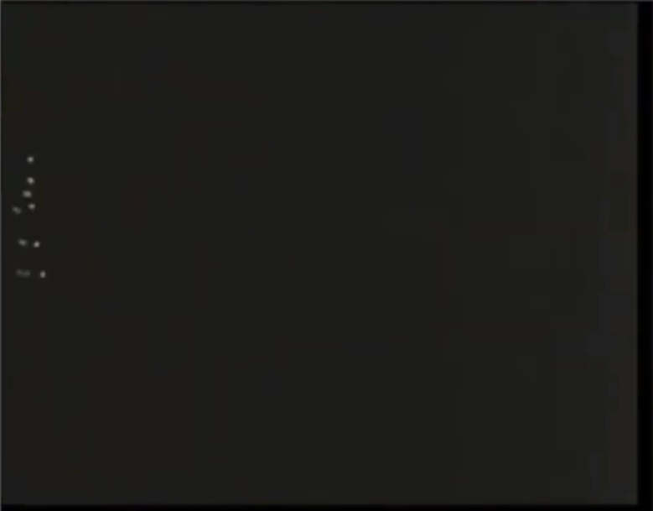
Introduction and Motivation
Action Recognition
Identify people’s actions a video/image sequence
For self-driving cars: understand the environment, make safe decision and plan reasonable path
Problem Description
Input: a video or a sequence of images
Output: the type of actions for every person inside
Motivation for Pose-Based Methods
Human poses are light-weight but highly informative representation
Successful work on pose estimation and pose based vision
Video Source: Justin Johnson. Umich. Deep Learning for Computer Vision. Lecture 18. 2020 Fall
Notes:
and that is almost action recognition, to identify people’s actions, a difference is that in realistic scenarios, we have a video instead of an image.
Action recognition is important for autonomous driving, because an autonomous vehicle has to understand the environment, understand what people and other vehicles are doing, and then make its decision or plan its path.
precisely, in action recognition task, we take a … as input, and then predict the ..
In my project, I’m working with methods that are based on human poses
Firstly, human poses are light-weight but surprisingly informative, and we can clearly recognize what these person are doing, even if we just see a few points in this video
Secondly, there has been successful work on pose estimation and pose based vision, which are my related work

Slide 4
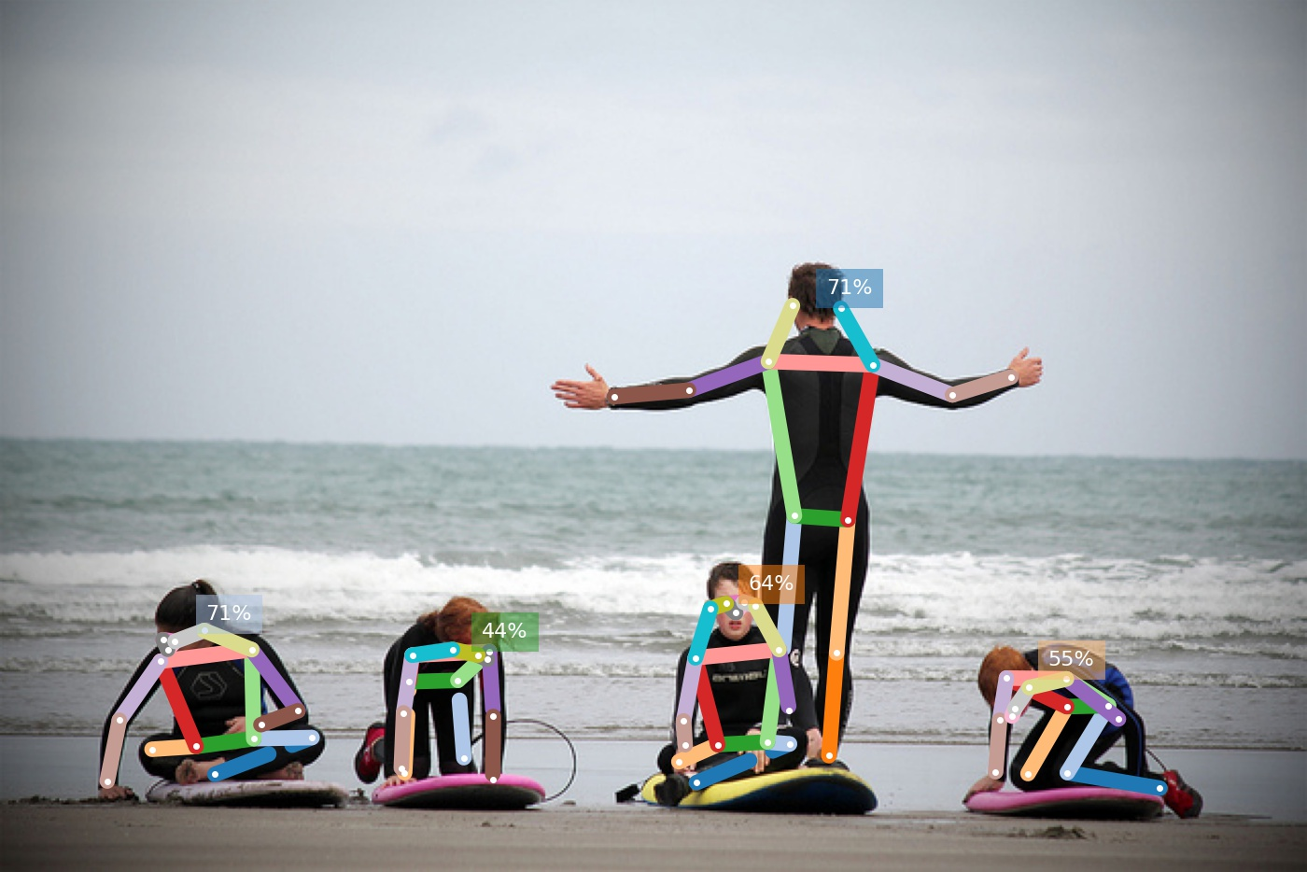
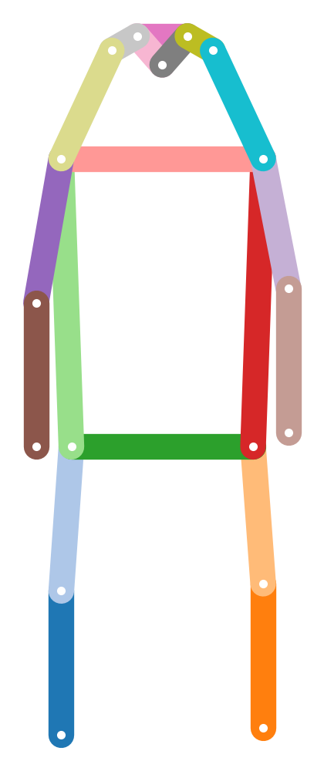
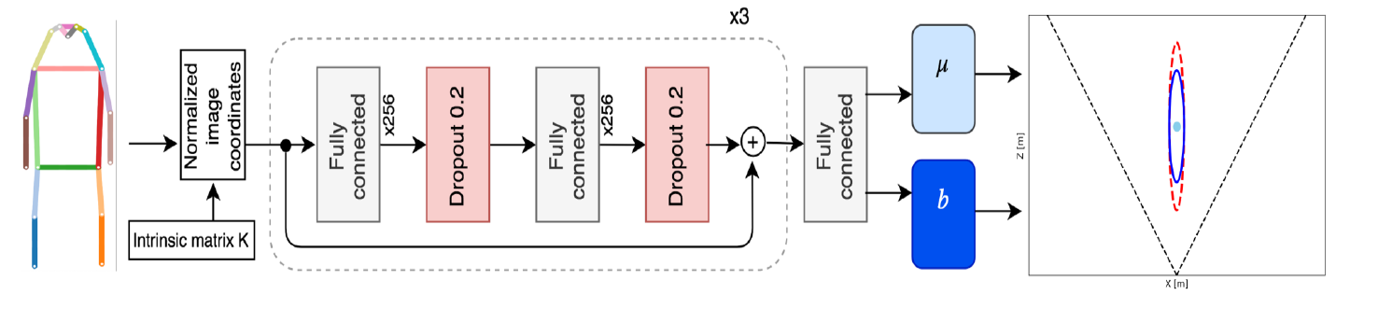
Related Work
OpenPifPaf and MonoLoco
OpenPifpaf can extract human body poses from images
Monoloco takes 2D poses and predicts 3D localization
Inspiration: use the base network of Monoloco, and adjust prediction head
OpenPifpaf: Sven Kreiss et al., OpenPifPaf: Composite Fields for Semantic Keypoint Detection and Spatio-Temporal Association. arXiv:2103.02440.
Monoloco: Lorenzo Bertoni et al., Monoloco: Monocular 3d pedestrian localization and uncertainty estimation. ICCV2019
Notes:
concretely, my project is most related with two works in the lab, openpifpaf and monoloco
pifpaf can accurately estimate 2D human poses from images
monoloco takes the 2D poses as input, and produces 3D localization for the persons inside.
the success of monoloco indicates that we can infer what’s going on in the 3d space based on 2d poses
inspired by this, I’m also using a similar workflow in my project, with adjustments to different datasets

Slide 5
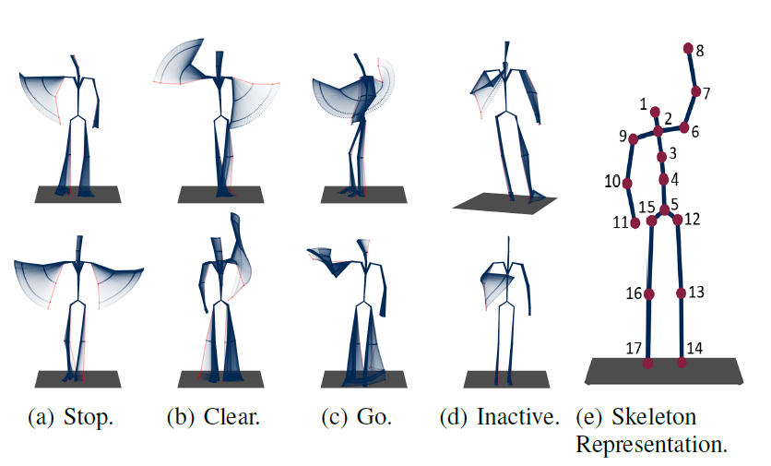
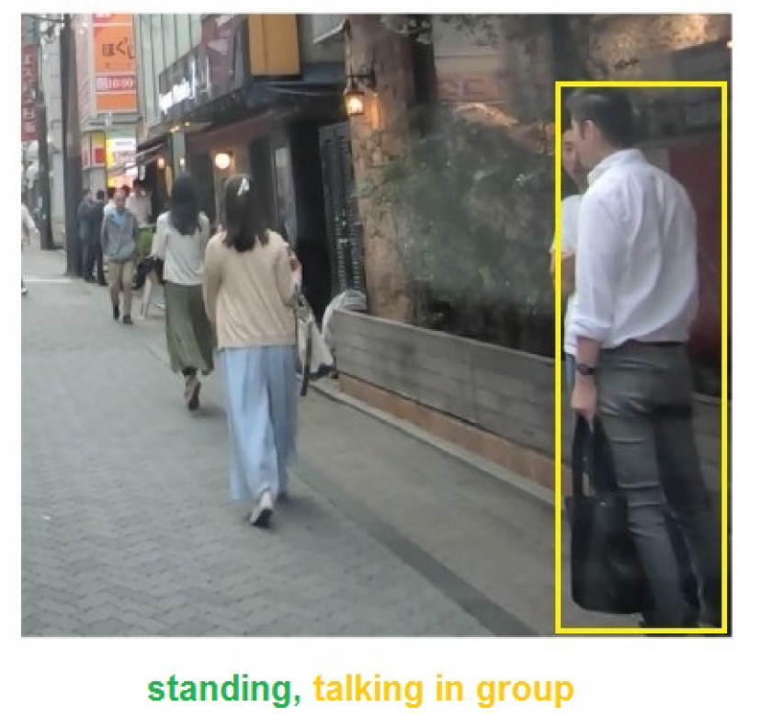
Datasets and Evaluation
TCG Dataset
Traffic Control Guesture according to German regulations
Consists of 550 sequences of 3D body poses
Actors observed from multiple view points (cross-view evaluation) and by multiple observers (cross subject)
TITAN Dataset
Video clips captured with an onboard camera (run OpenPifpaf)
Labels organized in hierarchy, from individual actions (standing) to those involving context (talking in group)
Five groups: Atomic, Simple context, Complex Context, Transportive, Communicative
TCG Dataset: Wiederer et al., Traffic Control Gesture Recognition for Autonomous Vehicles. IROS 2020 TITAN Dataset: Malla Srikanth et al., "Titan: Future forecast using action priors." CVPR 2020
Notes:
let’s first look at the datasets
I first did some experimental tests on TCG dataset, and then advanced to TITAN dataset.
The TCG dataset is made according to traffic control guesture in Germany, and it consists of 550 sequences of 3d body poses
In these sequences, the actor, who is making these guestures, is observed from multiple view points and by different observers.
And this dataset has a evaluation protocol to make use of these view points and observers, which are called
The titan dataset has video clips from an onboard camera, and people’s actions are organized in a hierarchy, from individual actions such as standing, to those involving the context, like talking in group
Specifically, the hierarchy contains these five groups of actions
average precision: https://en.wikipedia.org/wiki/Evaluation_measures_(information_retrieval)#Average_precision

Slide 6
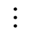

Proposed Methods (Baseline)
Base Network
$$× N$$
Linear Layer
Dropout
Linear Layer
Dropout
Embedded Features
Prediction head
Prediction heads
Dataset | TCG | TCG | TITAN
Model Name | MonoLoco | MonoLoco+LSTM | MonoLoco
Prediction head
Temporal Info | No | Yes | No
Spatial Relation | No Need | No Need | No
Linear
Linear 1
Linear 5
$$⋯$$
Linear
LSTM
Notes:
(use an arrow animation whel taking about these stuff)
based on the properties of the two datasets, I modified the original monoloco model
the base network remains the same, but prediction heads are changed accordingly.
The TCG datasets has 3D human poses already, and the basic model just take these poses as input, and predict the action frame by frame with a linear layer, without considering any temporal information
In contrast, the temporal model has an LSTM to predict the action across time.
A sequence in TCG just have one person, so we don’t need to consider spatial relation ship
As for the TITAN dataset, because it has 5 groups of actions, the model needs 5 different linear layers, one for each group.

Slide 7
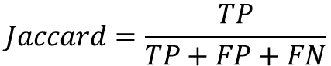
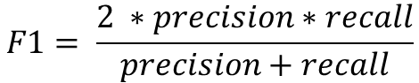
Action Recognition Baseline on TCG
Method | Cross-subject (%) |  |  | Cross-view (%)
Method | Accuracy | Jaccard | F1 | Accuracy | Jaccard | F1
RNN | 82.81 | 57.40 | 69.45 | 80.94 | 57.21 | 69.98
GRU | 84.44 | 58.16 | 70.45 | 83.47 | 56.25 | 68.59
LSTM | 83.23 | 56.32 | 68.59 | 79.58 | 52.02 | 64.62
Att-LSTM | 85.67 | 50.70 | 61.87 | 85.30 | 59.87 | 71.20
Bi-GRU | 86.80 | 57.25 | 68.95 | 87.37 | 55.55 | 67.68
Bi-LSTM | 87.24 | 67.00 | 78.48 | 86.66 | 65.95 | 77.14
TCN | 83.44 | 62.06 | 74.23 | 82.66 | 63.97 | 75.95
GCN | 65.42 | 38.55 | 50.73 | 62.40 | 35.05 | 48.51
MonoLoco | 85.03 | 63.72 | 76.91 | 86.29 | 68.76 | 80.81
MonoLoco+LSTM | 87.31 | 69.15 | 81.15 | 87.74 | 70.11 | 81.89
$$Jaccard=\frac{TP}{TP+FP+FN}$$
Results from TCG paper
$$F1= \frac{2 ∗precision∗recall}{precision+recall}$$
Temporal info helps, but may not be crucial for TCG
Embedded feature are better raw coordinates of key points
All methods in the TCG paper takes raw keypoint as input
Notes:
so that’s the baseline models, let’s see how they work
The TCG paper examed 8 models in total, and compared these models using accuracy, jaccard index and F1 score.
Then, what observations do we have?
If we look at our own models, the temporal model did better than the single frame model, therefore temporal information can help improve the classification performance.
Meanwhile, the single frame model is quite close to bidirectional LSTM, which is the best among the 8 methods in TCG paper, so the effect of temporal information may not be crucial for TCG.
Besides, our temporal model is better than LSTM, which means the monoloco base network provides better feature than raw coordinates of the keypoints
add the formula of jaccard and F1 score here
the slurm job number for MonoLoco are 779136 and 779137, and those for the Temporal model are 779140 779141

Slide 8
Action Recognition Baseline on TITAN
Results from TITAN paper
Classification Accuracy on Testset
Method | I3D | 3D ResNet | MonoLoco
Backbone | InceptionV1 | ResNet50
atomic | 0.9219 | 0.7552 | 0.8001
simple context | 0.5318 | 0.3173 | 0.4797
complex context | 0.9881 | 0.9880 | 0.9780
communicative | 0.8649 | 0.8648 | 0.8369
transportive | 0.9080 | 0.9081 | 0.8980
overall | 0.8429 | 0.7667 | 0.7985
Notes:
That’s the results on TCG, and now let’s move on to TITAN.
TITAN has images only, so we need to run openpifpaf first to get human poses, and then put these poses to MonoLoco model.
Up to now I only tested this most basic single frame model, without spatial and temporal reasoning.
and the overall accuracy looks perfectly fine, it’s almost 80%, but the truth is actually the opposite
add a column for percentage of “none of the above”
include another table for each category separately, and also include percentage of each class
slurm-780243_4294967294

Slide 9
Per-Class Recall (%) on TITAN
category | action type | Rec. | data%
communicative | looking into phone | 0 | 6.05
 | talking in group | 0 | 6.99
 | talking on phone | 0 | 3.21
 | none of the above | 0.999 | 83.76
complex context | getting in 4 wv | 0.018 | 0.13
 | getting off 2 wv | 0 | 0.23
 | getting on 2 wv | 0 | 0.12
 | getting out of 4 wv | 0 | 0.06
 | loading | 0 | 0.20
 | unloading | 0.046 | 0.75
 | none of the above | 0.992 | 98.50
atomic | bending | 0.362 | 2.17
 | jumping | 0 | 0
 | laying down | 0 | 0
 | running | 0 | 0.92
 | sitting | 0.527 | 4.37
 | squatting | 0 | 0.03
 | standing | 0.129 | 15.73
 | walking | 0.978 | 76.60
category | action type | Rec. | data%
atomic | none of the above | 0 | 0.17
simple context | biking | 0.493 | 3.86
 | cleaning an object | 0 | 0.45
 | closing | 0 | 0.15
 | crossing legally | 0.239 | 7.64
 | entering a building | 0 | 0.67
 | exiting a building | 0.016 | 0.75
 | crossing illegally | 0.038 | 7.22
 | motorcycling | 0.3 | 0.09
 | opening | 0 | 0.22
 | waiting to cross | 0.022 | 1.27
 | walking on the side | 0.604 | 35.82
 | walking on the road | 0.703 | 25.34
 | none of the above | 0.269 | 16.54
transporting | carrying | 0.009 | 6.33
 | pulling | 0 | 0.88
 | pushing | 0.062 | 2.48
 | none of the above | 0.992 | 90.32
majority class
Notes:
if we look at the classes separately, we can see the data are highly imbalanced.
For example, in these communicative actions, more than 80% are “none of the above”, which means the person is not doing any of the other three actions.
And our model is simply giving “none of the above” all the time, which is bad.
slurm-780243_4294967294

Slide 10
Action Recognition Baseline on TITAN
Classification Accuracy on Testset
unweighted average over the action types
Method | I3D | 3D ResNet | MonoLoco
Metric | Accuracy | Accuracy | Accuracy | Jaccard | F1
atomic | 0.9219 | 0.7552 | 0.8001 | 0.2405 | 0.3144
simple | 0.5318 | 0.3173 | 0.4797 | 0.1238 | 0.1927
complex | 0.9881 | 0.9880 | 0.9780 | 0.1457 | 0.1529
communicative | 0.8649 | 0.8648 | 0.8369 | 0.2093 | 0.2278
transportive | 0.9080 | 0.9081 | 0.8980 | 0.2386 | 0.2634
overall | 0.8429 | 0.7667 | 0.7985 | 0.1916 | 0.2302
Observations
low score if always “none”
Highly imbalanced data, challenging for a classifier
Overall accuracy alone is not sufficient, we need multiple metrics
Notes:
Since the overall accuracy can not tell whether the model is good or bad, I computed the jaccard index and F1 score again
they are averaged over the classes, as we did for TCG dataset, so the model won’t get high score by predicting the majority class all the time
From these experiments, we find that the data in TITAN is highly imbalanced, which is challenging, and we need multiple metrics to evaluate the models.
slurm-780243_4294967294

Slide 11
Discussions and Future Work
Current Progress
Learned about action recognition (datasets and related methods)
Prepared coding framework and evaluation metrics
Tested baseline models on TCG and TITAN
Encountered Problems
Need to tackle imbalanced data
Need to exploit spatial relations between different persons
Need to make use of temporal information
Future Plans
For imbalanced data: manually weight the classes; focal loss; uncertainty (like Monoloco)
Spatial and temporal relation: self-attention mechanism
Notes:
In summary, I have learned the basics of action recognition, prepared the coding framework, and examed some baseline models.
And currently there are three problems that I need to solve, which are imbalanced data, spatial relations and temporal relations.
manually weight the samples inversely to their percentages, focal loss, uncertainty based loss (in TITAN paper equation 2)
talk about these ideas

Slide 12
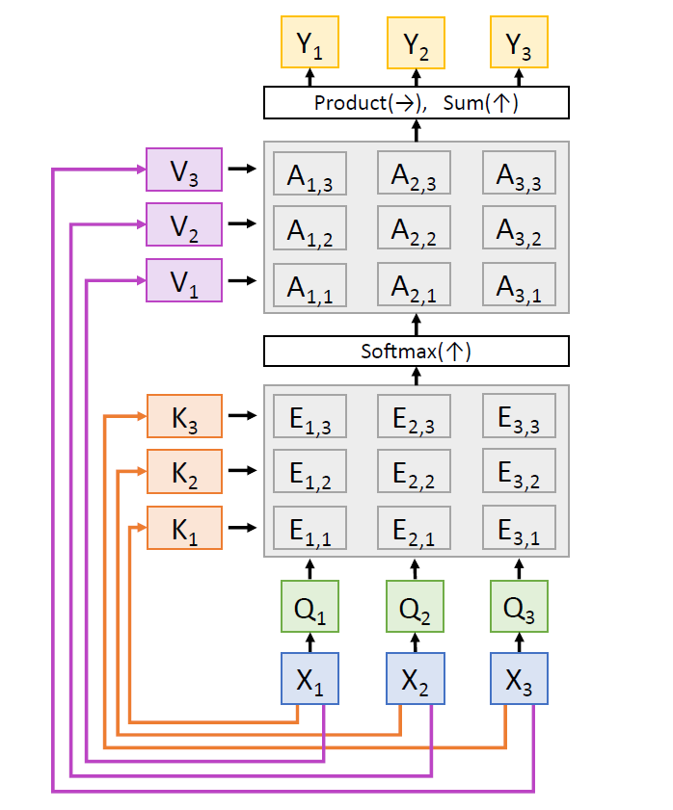
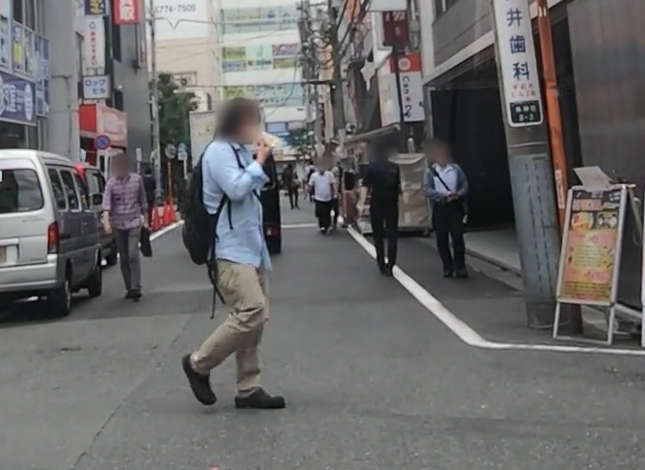
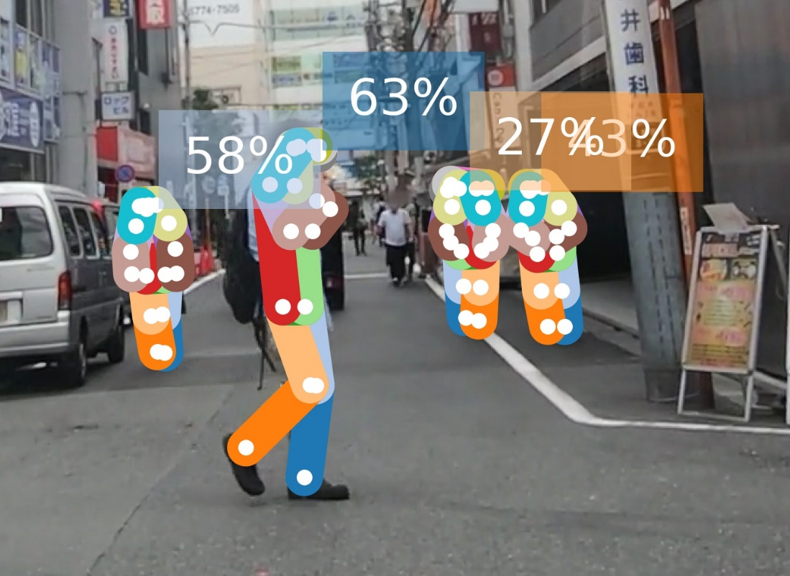

Progress Idea
Self-Attention for Spatial Reason
Key Points
Key Points
Key Points
$$⋯$$
X₁
X₂
X₃

Slide 13
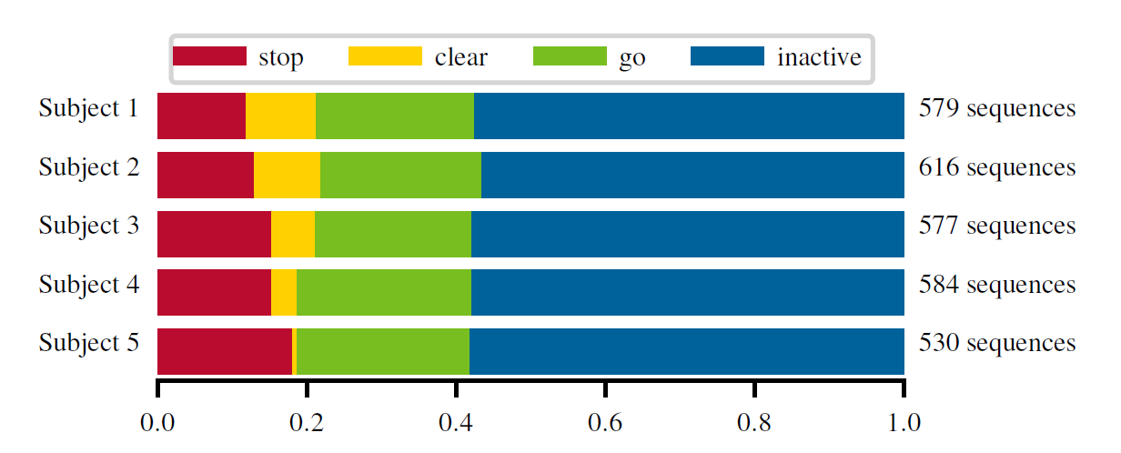
TCG Data Distribution
Notes:
447913

Slide 14
TITAN Data Distribution (%)
category | action type | train | val | test
communicative | looking into phone | 5.53 | 5.26 | 6.05
 | talking in group | 9.94 | 12.98 | 6.99
 | talking on phone | 2.15 | 1.84 | 3.21
 | none of the above | 82.37 | 79.92 | 83.73
complex context | getting in 4 wv
 | getting off 2 wv
 | getting on 2 wv
 | getting out of 4 wv
 | loading
 | unloading
 | none of the above
atomic | bending
 | jumping
 | laying down
 | running
 | sitting
 | squatting
 | standing
 | walking
category | action type | train | val | test
atomic | none of the above
simple context | biking
 | cleaning an object
 | closing
 | crossing legally
 | entering a building
 | exiting a building
 | crossing illegally
 | motorcycling
 | opening
 | waiting to cross
 | walking on the side
 | walking on the road
 | none of the above
transporting | carrying
 | pulling
 | pushing
 | none of the above
Notes:
447913

Slide 15
TITAN Perclass Evaluation
category | action type | Acc | Jac | F1
communicative | looking into phone
 | talking in group
 | talking on phone
 | none of the above
complex context | getting in 4 wv
 | getting off 2 wv
 | getting on 2 wv
 | getting out of 4 wv
 | loading
 | unloading
 | none of the above
atomic | bending
 | jumping
 | laying down
 | running
 | sitting
 | squatting
 | standing
 | walking
category | action type | Acc | Jac | F1
atomic | none of the above
simple context | biking
 | cleaning an object
 | closing
 | crossing legally
 | entering a building
 | exiting a building
 | crossing illegally
 | motorcycling
 | opening
 | waiting to cross
 | walking on the side
 | walking on the road
 | none of the above
transporting | carrying
 | pulling
 | pushing
 | none of the above
Notes:
447913

Slide 16
Image Classification
single image
single object
Object Detection
single image
multiple objects
extend
space
extend
time
extend
time
Action recognition aka video classification
image sequence
single (fixed) object
Action Recognition for self-driving cars
image sequence
multiple (varying) objects
extend
space

Slide 17

Drawings
$$× N$$
Linear Layer
Dropout
Linear Layer
Dropout
Out Feature
Linear

